Slide 1

DATABASE SYSTEMS (EIE36E): Of constraints and database integrity
Doc. Ing. Václav Vostrovský Ph.D.
Ing. Petr Hanzlík

Slide 2

Outline > Database integrity
Database integrity
Integrity constraints
Entity integrity
Domain integrity
FOREIGN KEY, Referential integrity
Parent and child table

Slide 3
Database integrity
Database integrity is maintained in a DBMS by a set of integrity rules called Integrity constraints. The main aim is to ensure that all data in the database are accurate, valid, and consistent.
Maintained on three basic levels:
Entity integrity
Domain integrity
Referential integrity

Slide 4
ORACLE DB : Integrity constraints
Prevent invalid data entry into the base tables
Enforce the business rules you want to associate with the information in a database
NOT NULL
UNIQUE
PRIMARY KEY
FOREIGN KEY
CHECK
REF

Slide 5
ORACLE DB : Integrity constraints
NOT NULL
Prohibits a database value from being null.
UNIQUE
Prohibits multiple rows from having the same value in the same column or combination of columns but allows some values to be null.
PRIMARY KEY = NOT NULL + UNIQUE

Slide 6
Entity integrity
Each entity must be distinguishable from other by at least single value.
This is accomplished by defining PRIMARY KEY over a column or columns, which ensures values of the given attribute (or their combination) is UNIQUE and NOT NULL
CREATE TABLE customer (
customerID CHAR(4) PRIMARY KEY,
name VARCHAR(30),
address VARCHAR(60),
birtdate DATE
);

Slide 7
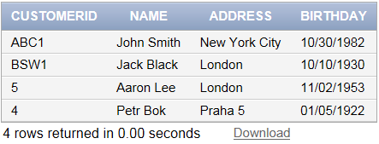


Entity integrity : prove
INSERT INTO customer
VALUES ('GO','Aaron Lee','London','11.02.1953')
INSERT INTO customer
VALUES ('BSW1','Aaron Lee','London','11.02.1953')
ORA-00001: unique constraint (DBSPACE.SYS_C007287) violated

Slide 8
Domain integrity
Domain integrity specifies that all attributes must be declared upon a defined domain. This is accomplished by specifying data type and length (precision).
CREATE TABLE customer (
customerID CHAR(4) PRIMARY KEY,
name VARCHAR(30),
address VARCHAR(60),
birthdate DATE
);

Slide 9
Domain integrity : prove
INSERT INTO customer
VALUES ('GO','Aaron Lee','London','11.02.1953')
INSERT INTO customer
VALUES ('BSW12','Aaron Lee','London','11.02.1953')
ORA-12899: value too large for column “BDSPACE"."CUSTOMER"."CUSTOMERID" (actual: 5, maximum: 4)

Slide 10
Domain integrity
The CHECK constraint enable fine-tuning of the domain specification by requiring a value in the database table to comply with a specific business rule.
CREATE TABLE customer (
customerID CHAR(4) PRIMARY KEY,
name VARCHAR(30),
address VARCHAR(60),CHECK(address IN ('London', 'Praha 5', 'New York City')),
birtdate DATE
);

Slide 11
Domain integrity : prove
INSERT INTO customer
VALUES ('GO','Aaron Lee','London','11.02.1953')
INSERT INTO customer
VALUES ('GO12','Aaron Lee','Munich','11.02.1953')
ORA-02290: check constraint DATASYS.SYS_C007342) violated

Slide 12
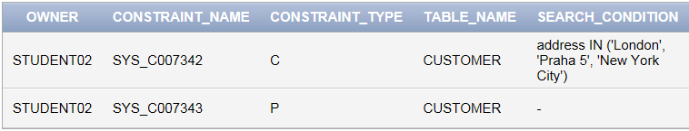
ORACLE DB : Integrity constraints
Not all the constraints are presented in the table description. To show them all:
Show user defined constraints SYNTAX
SELECT * FROM user_constraints
WHERE table_name = <your table name>;

Slide 13
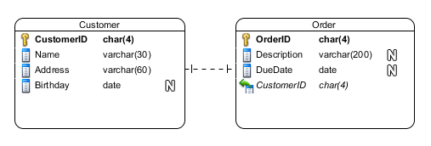
Referencing tables – FOREIGN KEY
In relational data model, individual tables are connected using keys
CustomerID in the „Order table“ is defined as FOREIGN KEY. Its values match the values of CustomerID declared as „Customer table“ primary key

Slide 14
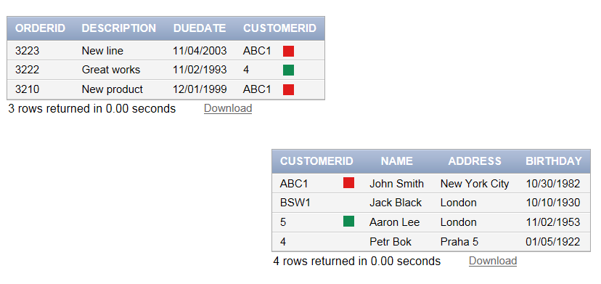
Referencing tables – FOREIGN KEY
Binding two tables with „CustomerID“ key

Slide 15
Referencing tables – FOREIGN KEY
Create a table ‘orders’, which links to customer table using customerID
Take note: The referenced table and column must already exist!
CREATE TABLE orders
(orderID NUMBER(4) PRIMARY KEY,
Description VARCHAR(200),
DueDate DATE,
customerID char(4) NOT NULL,
FOREIGN KEY (customerID) REFERENCES customer(customerID))
;

Slide 16
Referential integrity
The main benefit of the referential integrity is the data consistency. It tells what will happen if one of the tables in relation is changed.
Parent table and child table handle operations in a different way

Slide 17
Referential integrity
From the primary key perspective:
Child table
Parent table

Slide 18
Referential integrity - Insert
INSERT INTO order VALUES ('3211','Screwdriver','12.01.2002','ABC1');
INSERT INTO order VALUES ('3211','Screwdriver','12.01.2002','ADDD');
ORA-02291: integrity constraint (STUDENT02.SYS_C007356) violated - parent key not found

Slide 19
Referential integrity - Delete
You can freely delete from the child table, but what will happen if a referenced data from the parent table are attempted to be changed?
DELETE customer where customerid like ‘5%'
DELETE customer where customerid like '4%'
ORA-02292: integrity constraint (STUDENT02.SYS_C007356) violated
- child record found
Notes:
Watch out, the delete procedure can be set up in many different ways. It can also differ from one RDBMS to another.

Slide 20
Referential integrity - Delete
Deleting the data can be set up in a DBMS
Cascading the delete in a way all the referencing entities from the child table are erased too
Updating the corresponding property of the referencing entity to NULL
Preventing the delete from happening (default)

Slide 21
Referential integrity – ON DELETE
ON DELETE constraint enables setting up what happens with the referencing entities if the parental entity is removed
ON DELETE Syntax:
CREATE TABLE <table_name>
(<column_name> <datatype> <constraints>, .. ,
<fkey_column_name> <datatype>,
FOREIGN KEY (fkey_column_name) REFERENCES <parent_table_name> (parent_column_name)
[ON DELETE {CASCADE|NULL|NO ACTION}] );
Notes:
Watch out, the delete procedure can be set up in many different ways. It can also differ from one RDBMS version to another.

Slide 22
ON DELETE : example
Enable cascade delete when creating the table
CREATE TABLE order
(orderID NUMBER(4) PRIMARY KEY,
Description VARCHAR(200),
DueDate DATE,
customerID char(4) NOT NULL,
FOREIGN KEY (customerID) REFERENCES customer(customerID))
ON DELETE CASCADE ;

Slide 23
ON DELETE : example
Modify a table to enable cascade delete:
ALTER TABLE orders DROP CONSTRAINT <constraint_name>;
ALTER TABLE order ADD CONSTRAINT fk_cust
FOREIGN KEY(customerID)REFERENCES customer(customerID)
ON DELETE CASCADE;

